Slide 1
SCRUM TEAM
--What is scrum team??
--What does scrum team work for?
--What are the Roles in scrum team?
--what are the responsibilities of the team members?

Slide 2
What is the SCRUM?
Scrum is a platform that helps teams work together.
Scrum encourages teams to learn through experiences, self-organize while working on a problem, and reflect on their wins and losses to continuously improve.

Slide 3
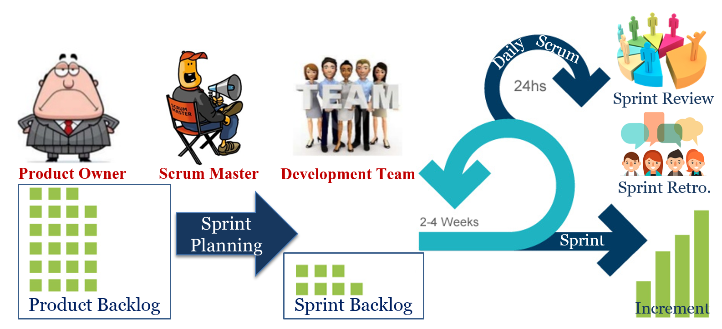

Slide 4
WHAT IS SCRUM TEAM?
A Scrum Team is a collection of individuals working together to deliver the required product increments. The Scrum framework encourages a high level of communication among team members, so that the team can:
Follow a common goal
adhere the same norms and rules
show respect to each other

Slide 5
SCRUM TEAM ROLES
Product owner
Scrum master
Development team

Slide 6
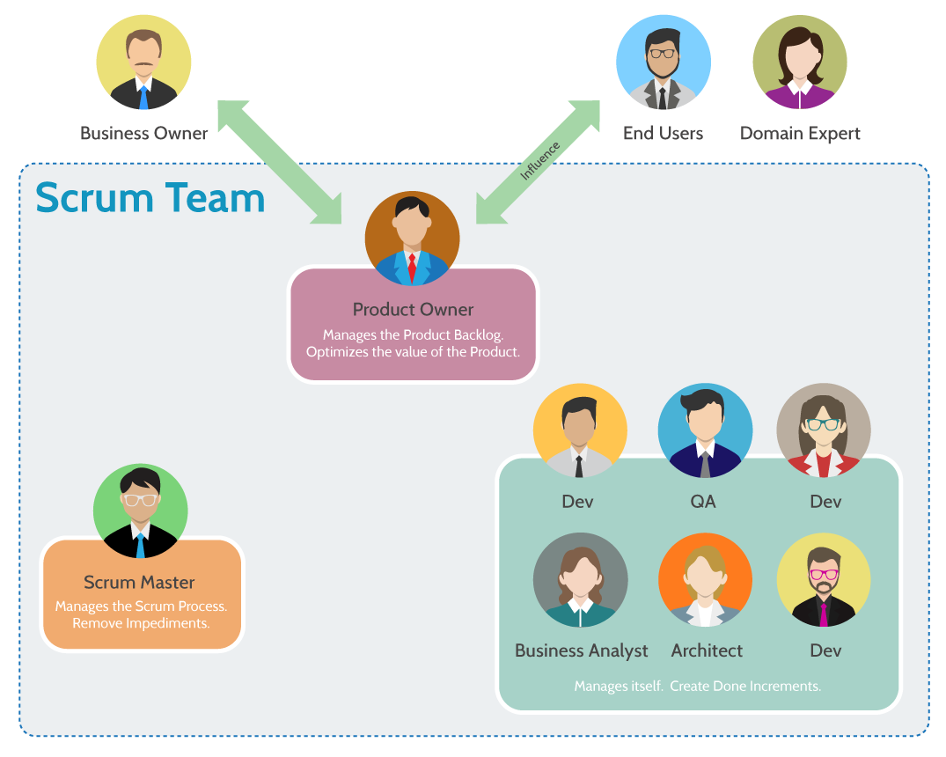

Slide 7
PRODUCT OWNER
Owner is the Team member who knows what the customer wants and the relative business value of those wants. He or she can then translate the customer’s wants and values back to the Scrum team. The Product Owner must know the business case for the product and what features the customers’ wants. He must be available to consult with the team to make sure they are correctly implementing the product vision. Most importantly, he must have the authority to make all decisions necessary to complete the project, in other words, the Product Owner is responsible for managing the Product Backlog which includes:

Slide 8
PO Responsibilities
Expressing Product Backlog items clearly.
Ordering the Product Backlog items to best achieve goals and missions.
Optimizing the value of the work the Team performs.
Ensuring that the Product Backlog is visible, transparent, and clear to all, and shows what the Team will work on further.
Ensuring that the Team understands items in the Product Backlog to the level needed.
Sprint Planning
Creates the user stories
Owner of the Scrum Product Backlog

Slide 9
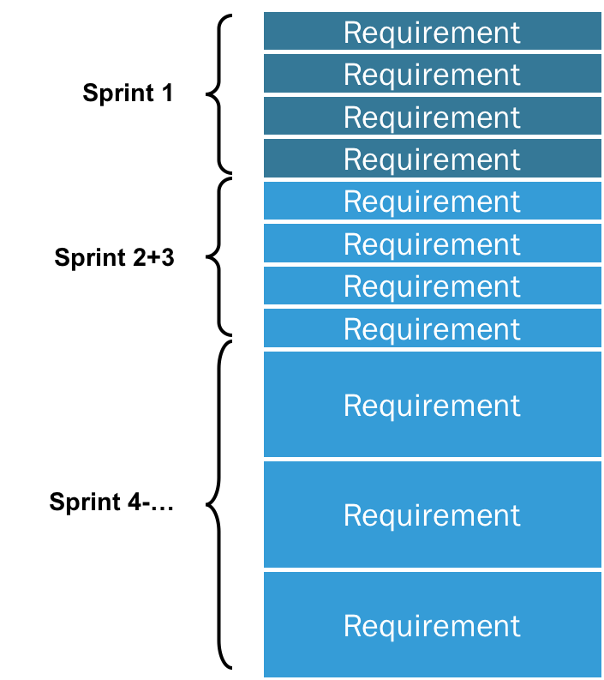
QUICK CHECK-PRODUCT BACKLOG
Product Backlog is an ordered list of everything that is known to be needed in the product.

Slide 10
QUICK CHECK-SPRINT PLANNING
The What – The product owner describes the goal. The scrum team decides what can be done in the coming sprint and what they will do during the sprint to make that happen.
The How – The development team plans the work necessary to deliver the sprint goal. Ultimately, the resulting sprint plan is a negotiation between the development team and product owner based on value and effort.
The Inputs – A great starting point for the sprint plan is the product backlog The team should also look at the existing work done in the increment and have a view to capacity.
The Outputs – The most important outcome for the sprint planning meeting is that the team can describe the goal of the sprint and how they will start working toward that goal. This is made visible in the sprint backlog.

Slide 11
QUICK CHECK – USER STORIES
A user story is a very high-level definition of a requirement, containing just enough information so that the developers can produce a reasonable estimate of the effort to implement it.

Slide 12
User story examples In practice, user stories might look like these:
As a database administrator, I want to automatically merge datasets from different sources so that I can more easily create reports for my internal customers.
As a brand manager, I want to get alerts whenever a reseller advertises our products below agreed-upon prices so that I can quickly take action to protect our brand.
As the leader of a remote team, I want our team-messaging app to include file sharing and annotation so that my team can collaborate in real-time and keep an archive of their work in a single place.

Slide 13
What is Sprint Review?
The sprint review is an informal meeting which the development team, the scrum master, the product owner and the stakeholders will attend. The team gives a demo on the product and will determine what are finished and what aren’t. The purpose of the Sprint Review meeting is for the team to show the customers and stakeholders the work they have accomplished over the sprint and compare it to the commitment given at the beginning of the sprint.

Slide 14
What is a Sprint Retrospective?
The Sprint Retrospective occurs after the Sprint Review and prior to the next Sprint Planning. This is at most a three-hour meeting for one-month Sprints. For shorter Sprints, the event is usually shorter. The Scrum Master ensures that the event takes place and that attendants understand its purpose. This is the opportunity for the Scrum Team to improve and all member should be in attendance.

Slide 15
During the Sprint Retrospective, the team discusses:
What went well in the Sprint
What could be improved
What will we commit to improve in the next Sprint

Slide 16
The Scrum Master encourages the Scrum Team to improve its development process and practices to make it more effective and enjoyable for the next Sprint. During each Sprint Retrospective, the Scrum Team plans ways to increase product quality by improving work processes or adapting the definition of “Done” if appropriate and not in conflict with product or organizational standards.
By the end of the Sprint Retrospective, the Scrum Team should have identified improvements that it will implement in the next Sprint. Implementing these improvements in the next Sprint is the adaptation to the inspection of the Scrum Team itself. Although improvements may be implemented at any time, the Sprint Retrospective provides a formal opportunity to focus on inspection and adaptation.

Slide 17
SCRUM MASTER
Help to keep the team accountable to their commitments to the business and also remove any roadblocks that might impede the team’s productivity. They met with the team on a regular basis to review work and deliverables, most often in a weekly cadence. The role of a scrum master is to coach and motivate team member, not enforce rules to them. The role of a scrum master includes:
ensure the process run smoothly
remove obstacles that impact productivity
organize the critical events and meeting

Slide 18
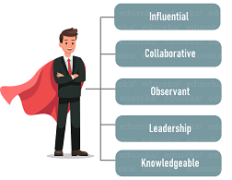
SCRUM MASTER
Scrum Master is “a facilitator for the team and the product owner. Rather than manage the team, the scrum master works to assist both the scrum team and the product owner.”

Slide 19
Scrum Master serves Product Owner in the following ways:
Makes sure that the goals and scope of the project are understood by everyone involved
Facilitates scrum events as and when requested by the product owner
Helps product owner find techniques for effective product backlog management
Ensure the product owner knows how to arrange the product backlog to maximize value
Helps product owner understand and practice agile practices

Slide 20
Scrum Master serves Development Team in the following ways:
Coaches the entire team in self-organizing and cross-functionality
Facilitates scrum events as requested and needed
Removes obstacles that could slow down the team’s progress
Helps development team create high-quality products
Guides the team organizational environments in which Scrum is not yet fully adopted and understood

Slide 21

DEVELOPMENT TEAM

Slide 22
Every role in development team, develops something…
Architects develops models, database schema and architecture.
Designers develops user interface and user experience.
Analysts develops business analysis, requirements, documentation and user manuals.
Programmers develops the code itself.
Test Engineer develops test cases, acceptance tests and the tests itself.

Slide 23
BUSINESS ANALYST
Grooming the product backlog based on the prioritization provided by the product owner.
Analyzing the customer needs and finding the solutions to address them.
Creating the requirements in the form of user stories with appropriate acceptance criteria.
If in case the user stories have been already created by the product owner (with acceptance criteria), then reviewing them to make sure that every business rule is covered and the acceptance criteria meet the user story functionality.
Working with the product owner and the stakeholders to understand the scope, suggest improvements to the requirements, etc.
Preparing documents like wireframes, design flow, UI etc., as and when required.

Slide 24
The BA guides the team, helps them to understand the requirements and even at times has to approve the implementation.

Slide 25
QUICK CHECK-GROOMING
Grooming (or refinement) is a meeting of the Scrum team in which the product backlog items are discussed and the next sprint planning is prepared.
Product grooming is critical in product management because it means keeping the backlog up to date and getting backlog items ready for upcoming sprints.
Backlog grooming is often named pre-planning. Product owner and team representatives arrange it in the mid-sprint time. In this case, planning and refinement meetings alternate but happen on the same day each week. That provides an effective rhythm for the entire team.
The grooming involves splitting big items into smaller ones, rewriting backlog items to be more expressive, deleting obsolete or no more need items, and so on.
Product owners should always keep the backlog tidy. Regular involving of team members is optional.
It is not a formal ceremony of the Scrum process.
Product owners identify user stories based on priorities for the next sprint planning. Groomed Scrum backlog helps to streamline sprint planning meetings to avoid stretching them for hours.

Slide 26

DEVELOPER

Slide 27
Area | Additional Responsibility
Task/Project Management | Taking responsibility for estimating, planning, and managing all of his/her own tasks and reporting on progress. This role is essentially what a project manager might do on a very small scale.
Effective Teamwork | Collaborating closely with all the other members of the team to take shared responsibility for the overall efforts that the team has committed to. This role is also similar to what a project manager might do but rather than being done by a single person with the title of “Project Manager”, the responsibility is distributed among all members of the team.
Software Quality | Taking responsibility for the quality of the software the developer produces. Instead of turning over some code to a separate and independent group for testing, the team, as a whole, takes responsibility for the quality of the work they produce. A developer may or may not do the testing himself/herself but the key point is that the quality of the code is not someone else’s responsibility.
Understanding User Needs | Interacting with users as necessary to clarify requirements. Developers will typically not be given a well-defined set of requirements. More often, the developer will get some general user stories that are intended to be a “placeholder for conversation” and the developer will be expected to interact with the Product Owner and users as necessary to better define what is needed. This is essentially equivalent to a Business Analyst role on a very small scale.

Slide 28
What exactly does a UX/UI designer do?
First things first: UX and UI design are two different elements of a single consumer experience. UX refers to the user experience, which focuses on how something works and how people interact with it. UI, or user interface, focuses on the look and layout.

Slide 29

QA
Created QA reports and file bug tickets based on the outcome of QA test cycles.
Provided feedback to developers and product managers around UX based on test outcomes.
Performed Front-end testing of website applications using Selenium and JMeter.
Created test plans, requirements, scenarios and test data for use during testing

Slide 30
TESTING TYPES
Functional Testing types include:
Non-functional Testing types include:
Unit Testing
Integration Testing
System Testing
Sanity Testing
Smoke Testing
Interface Testing
Regression Testing
Beta/Acceptance Testing
Performance Testing
Load Testing
Stress Testing
Volume Testing
Security Testing
Compatibility Testing
Install Testing
Recovery Testing
Reliability Testing
Usability Testing
Compliance Testing
Localization Testing

Slide 31
FUNCTIONAL TESTING
This type of testing ignores the internal parts and focuses only on the output to check if it is as per the requirement or not.
NON-FUNCTIONAL TESTING
Non-functional testing is defined as a type of Software testing to check non-functional aspects (performance, usability, reliability, etc) of a software application. It is designed to test the readiness of a system as per nonfunctional parameters which are never addressed by functional testing.
An excellent example of non-functional test would be to check how many people can simultaneously login into a software.
Non-functional testing is equally important as functional testing and affects client satisfaction.

Slide 32
Unit Testing
It is typically done by the programmer and not by testers, as it requires detailed knowledge of the internal program design and code. Unit Testing is used to design robust software components that help maintain code and eliminate the issues in code units.
Integration Testing
The meaning of Integration testing is quite straightforward- Integrate/combine the unit tested module one by one and test the behavior as a combined unit.
The main function or goal of this testing is to test the interfaces between the units/modules.
We normally do Integration testing after “Unit testing”. Once all the individual units are created and tested, we start combining those “Unit Tested” modules and start doing the integrated testing.
System Testing
System testing means testing the system as a whole. All the modules/components are integrated in order to verify if the system works as expected or not.

Slide 33
EXAMPLE FOR FIRST THREE TESTING
A car manufacturer does not produce the car as a whole car. Each component of the car is manufactured separately, like seats, steering, mirror, break, cable, engine, car frame, wheels etc.
After manufacturing each item, it is tested independently whether it is working the way it is supposed to work and that is called Unit testing.
Now, when each part is assembled with another part, that assembled combination is checked if assembling has not produced any side effect to the functionality of each component and whether both components are working together as expected and that is called integration testing.
Once all the parts are assembled and the car is ready, it is not ready actually.
The whole car needs to be checked for different aspects as per the requirements defined like if car can be driven smoothly, breaks, gears and other functionality working properly, car does not show any sign of tiredness after being driven for 2500 miles continuously, color of car is generally accepted and liked, car can be driven on any kind of roads like smooth and rough, sloppy and straight etc and this whole effort of testing is called System testing and it has nothing to do with integration testing.

Slide 34
Sanity Testing
Done one to determine if a new software version is performing well enough to accept it for a major testing effort or not. If an application is crashing for the initial use then the system is not stable enough for further testing. Hence a build or an application is assigned to fix it.
Smoke Testing
Smoke Testing is not exhaustive testing but it is a group of tests that are executed to verify if the basic functionalities of that particular build are working fine as expected or not. This is and should always be the first test to be done on any ‘new’ build. QA
Graphical User Interface (GUI) Testing
The objective of this GUI Testing is to validate the GUI as per the business requirement. The expected GUI of the application is mentioned in the Detailed Design Document and GUI mockup screens.
The GUI Testing includes the size of the buttons and input field present on the screen, alignment of all text, tables, and content in the tables.

Slide 35
Regression Testing
Regression Testing is a type of testing that is done to verify that a code change in the software does not impact the existing functionality of the product. This is to make sure the product works fine with new functionality, bug fixes or any change in the existing feature. Previously executed test cases are re-executed in order to verify the impact of change.
Beta Testing
Usually, this testing is typically done by end-users or others. It is the final testing done before releasing an application for commercial purpose. Usually, the Beta version of the software or product released is limited to a certain number of users in a specific area.
Acceptance Testing
UAT-BAT-QAT-RAT-CAT-Alpha-Beta

Slide 36
https://www.softwaretestinghelp.com/types-of-software-testing/

